Slide 1
IPL ANALYSIS WITH PYTHON
IT Department IV YEAR (2017 - 2021)
P. SURYA SARATH 17WJ1A1236
Under the Guidance of
P. NARESH (Assistant Professor)

Slide 2
TABLE OF CONTENT
1. ABSTRACK
2. HARDWARE & SOFTWARE REQUIRMENTS
3. ML ?
4. PHYTHON ?
5. ANACONDA & JUPYTER
6. WORKFLOW
7. ALGORITHM
8. LIBRARIES
9. UML
10. OUTPUT
11. TESTING
12. FUTURE ?
13. CONCLUSION

Slide 3
ABSTRACT
Data analytics techniques and algorithms are more used by the commercial industries which enables them to take precise business decisions.
In this project, the past twelve years' data of IPL containing the player's details, match venue details, teams, the ball to ball details, are taken and analyzed to draw various conclusions which help in the improvement of a player’s performance
Various other features like how the venue or toss decision has influenced the winning of the match in the last twelve years are also predicted.
Before prediction, we must explore and visualize the data because data exploration and visualization is an important stage of predictive modeling.

Slide 4
HARDWARE & SOFTWARE REQUIRMENTS
HARDWARE REQUIRMENTS:
PROCESSOR : DUAL CORE 2 DUOS.
RAM : 4GB DD RAM
HARD DISK : 250 GB
SOFTWARE REQUIRMENTS:
OPERATING SYSTEM : WINDOWS 7/8/10
PROGRAMMING LANGUAGE : PYTHON
PLATFORM : Anaconda Navigator
FRONT END : Jupyter Notebook

Slide 5
EXISTING SYSTEM
In existing system we are implementing IPL analysis using Conventional Algorithm
DRAWBACKS:
Less accuracy
Difficulty to predict

Slide 6
PROPOSED SYSTEM
In proposed system we are implementing IPL analysis using Random Forest Algorithm
ADVANTAGE:
Better Accuracy
Easy to predict

Slide 7
ML ?
Machine learning is a branch of artificial intelligence that aims at solving real life engineering problems.
It provides the opportunity to learn without being explicitly programmed and it is based on the concept of learning from data.
Itis so much ubiquitously used dozen a times a day that we may not even know it.
The advantage of machine learning(ML) methods is that it uses mathematical models, knowledge acquisitions and decision trees for decision making. Thus, it provides controllability, observability and stability.

Slide 8
PHYTHON ?
Python is a high-level, interpreted, interactive and object-oriented scripting language.
Easy-to-read − Python code is more clearly defined and visible to the eyes.
A broad standard library − Python's bulk of the library is very portable and cross platform compatible on UNIX, Windows, and Macintosh.
Interactive Mode − Python has support for an interactive mode which allows interactive testing and debugging of snippets of code.
Portable − Python can run on a wide variety of hardware platforms and has the same interface on all platforms
Scalable − Python provides a better structure and support for large programs than shell scripting

Slide 9
ANACONDA & JUPYTER NOTEBOOK
ANACONDA:
Anaconda is a package manager, an environment manager, and a collection of over 7,500+ open-source packages.
Anaconda also make your custom packages
JUPYTER NOTEBOOK :
The Jupyter Notebook is an open-source web application that allows you to create and share documents that contain live code, equations, visualizations and narrative text.
Includes: data cleaning and transformation, numerical simulation, statistical modeling, data visualization, machine learning, and much more.

Slide 10
WORKFLOW
Data Collection : This dataset will be comprised of data gathered from multiple and disparate sources which are then combined in a proper format to form a dataset Dataset formats differ according to use cases.
In our project the dataset gives the Kaggle and it has two dataset IPL Ball-by-Ball 2008-2020.csv and IPL Matches 2008-2020.csv
In data preprocessing phase, the data is incomplete, noisy and inconsistent. Data is to be filled with missing values and correct the inconsistencies. data validation is done by maintaining consistency across the dataset and data enhancement is done by adding related information to the dataset
Data Encoding : label each term with short names and encode them as numerical values for predictive modeling as implemented below.
Notes:
MI 1 RCB 2

Slide 11
Data Visualization: The most important and significant part of data visualization and predictive analysis is to represent the data in form of charts and graphs to get a visual presentation of data.
The collected data is visualized to get a better and clear understanding about all the parameters of the Season.
Learning Algorithm: The test dataset is taken as input to the learning algorithm, evaluates different scenarios like toss winner, toss decision and team winner. Thus, new data is obtained with final prediction.
Random Forest algorithm is proved to be the best accurate classifier.
Notes:
The scikit-learn Label Encoder is a python library which converts categorical variables to numeric variables and a predictive model is created using a generic function

Slide 12
RANDOM FOREST ALGORITHM
Random Forest Algorithm is a supervised learning
Random Forest is a classifier that contains a number of decision trees on various subsets of the given dataset and takes the average to improve the predictive accuracy of that dataset
In building of forest, the root node and splitting of the nodes will run according to the data set.
More number of nodes more accurate of result
Random forest handles the missing value
It reduces overfitting in decision trees and helps to improve the accuracy.
Also Create the Adequate Trees to improve accuracy
Notes:
It reduces overfitting in decision trees and helps to improve the accuracy.

Slide 13
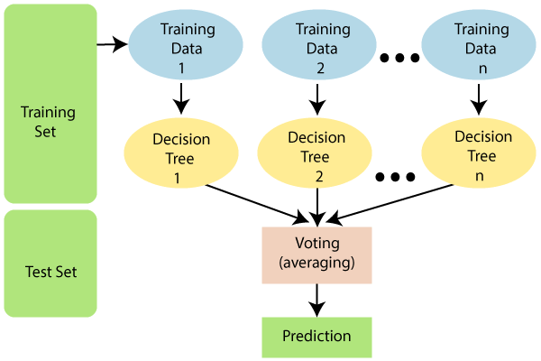

Slide 14
LIBRARIES
NumPy - Mainly useful for its N-dimensional array objects.
Pandas - Python data analysis library, including structures such as data frames.
Scikit-learn - The machine learning algorithms used for data analysis and data mining tasks.
Chart-studio – It provides a web-service for hosting graphs.

Slide 15
UML
STATE DIAGRAM

Slide 16
CLASS DIAGRAM

Slide 17
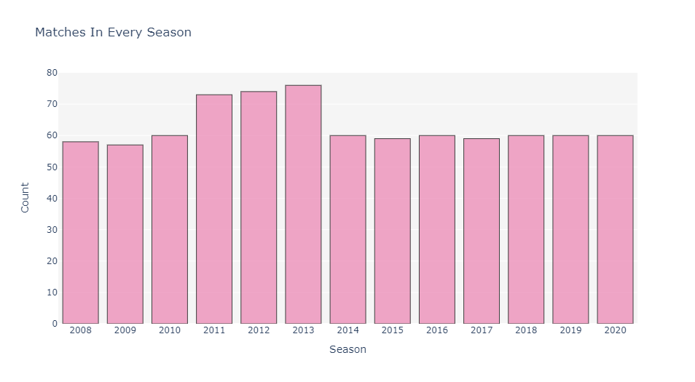
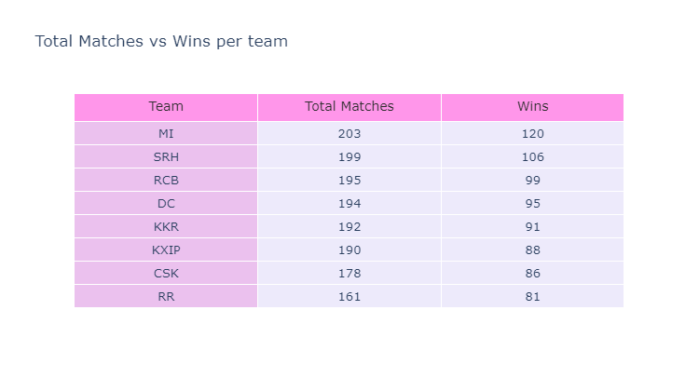
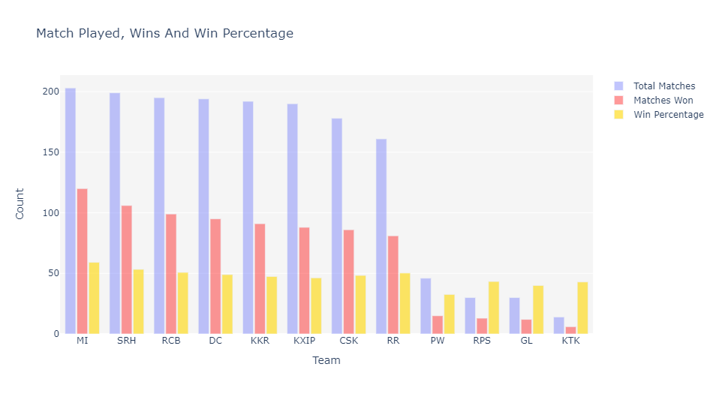
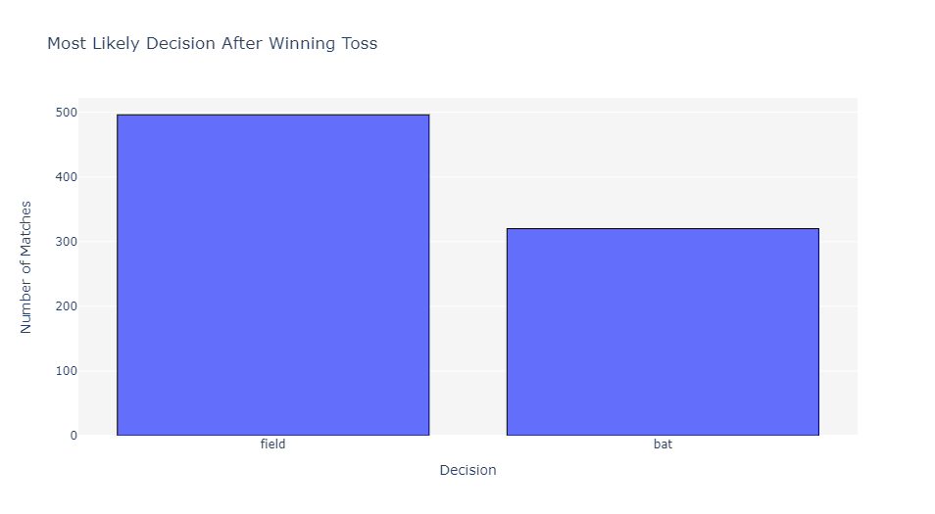
OUTPUT

Slide 18
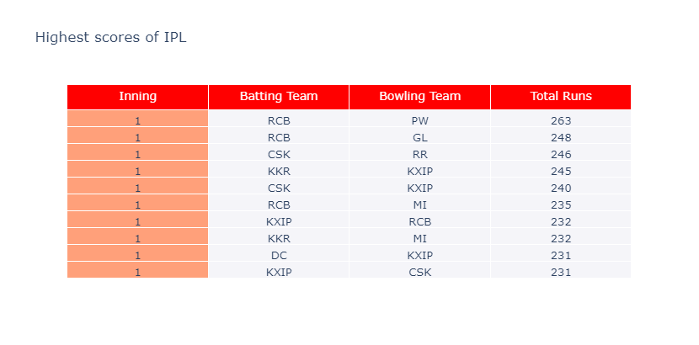
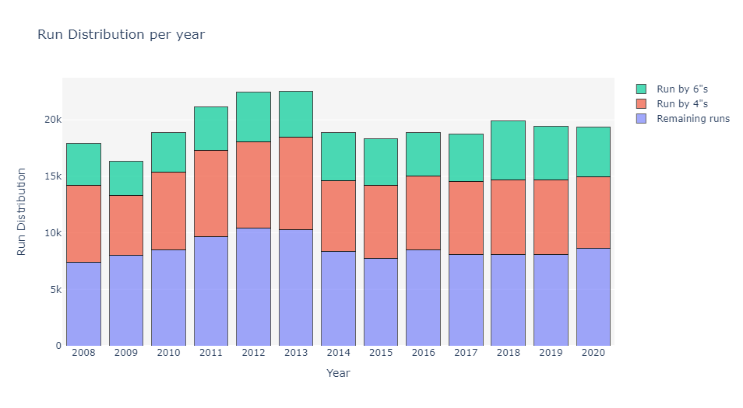

Slide 19
TESTING
Unit testing involves the design of test cases that validate that the internal program logic is functioning properly, and that program input produce valid outputs
System testing ensures that the entire integrated software system meets requirements.
The Performance test ensures that the output be produced within the time limits, and the time taken by the system for compiling, giving response to the users and request being send to the system for to retrieve the results.
Software integration testing is the incremental integration testing of two or more integrated software components on a single platform to produce failures caused by interface defects.
Functional tests provide systematic demonstrations that functions tested are available as specified by the technical requirements and user manuals. Functional testing is centered on the following items: valid input, output & Functions.

Slide 20
FUTURE ENHANCEMENT ?
This Data will be used in future to predict the winning teams for the next series IPL matches.
Hence using this prediction, the best team can be formed.
Project can be updated in near future as and when requirement for the same arises, as it is very flexible in terms of expansion
With the proposed software of database Space Manager ready and fully functional the client is now able to manage and hence run the entire work.
Like IPL analysis we can analysis the stock markets.

Slide 21
CONCLUSION
The main goal of this paper is to analyze the IPL cricket data.
Selection of the best team for a cricket match plays a significant role for the team’s victory.
Random Forest is observed to be the best accurate classifier with 89.15% to predict the best player performance.

